Slide 1
What is wrong with my flow cytometry data?
Hints, tricks and pitfalls
Core Facility for Cell Sorting and Cell Analysis

Slide 2
Webinar 6
04.07.2023
When to use which buffer system
2

Slide 3
What we need to talk about…
Staining protocol
Surface vs. intracellular vs. intranuclear
Cell Staining buffer
Blocking buffer
Perm buffer
Fixation buffer
Special
RBC lysis buffer
Annexin Binding buffer
Cell cycle buffer
3
Core Facility for Cell Sorting and Cell Analysis

Slide 4
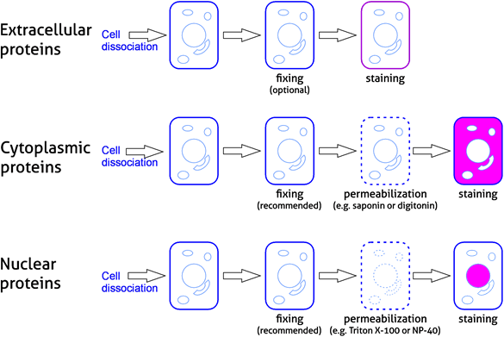
Staining strategies: what are you looking for
https://www.ptglab.com/media/5016/flow-cytometry-7.png?width=585px&height=391px
4
Core Facility for Cell Sorting and Cell Analysis

Slide 5
Simple staining buffer for surface staining
Self-made
1X PBS (w/o Mg²⁺, Ca²⁺ )
+ 1-2% BSA / FCS (heat-inactivated)
+ 2-5 mM EDTA
+ 2mM NaN₃ or 1% Pen/Strep
serum and EDTA concentrations depend on tendency of cells to aggregate
Commercial
Miltenyi autoMACS Running Buffer (BSA, EDTA, Acid) # 130-091-221
Miltenyi autoMACS Rinsing solution (EDTA) , # 130-091-222
BioLegend Cell Staining buffer, # 420201
5
Core Facility for Cell Sorting and Cell Analysis

Slide 6
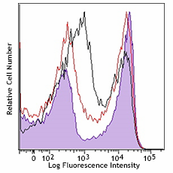
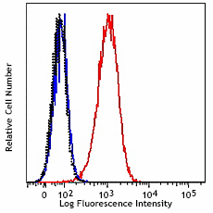
Blocking: not just an issues of Fc receptors
Self-made to block FcR
10% BSA/FCS in cell staining buffer
5-10 min on ice prior or simultanously with antibody incubation
Commercial
BioLegend TrueStain FcX PLUS (anti-mouse CD16/32)
α- CD16/32 blocking non-specific binding of Ig to Fc receptors
BioLegend Human TrueStain FcX
specialized human IgG binding to various Fc receptors via Fc portion
BALB/c splenocytes were incubated with TruStain FcX™ PLUS (clone S17011E, 0.25µg/10⁶ cells, filled histogram) or TruStain FcX™ (clone 93, 1µg/10⁶ cells, red line histogram) to block the Fc receptors, or were left untreated (black line histogram); then stained with CD90.2 (Thy-1.2, clone 53-2.1) FITC. Note the high background in the untreated cells and the bigger reduction in the background staining when the cells were incubated with TruStain FcX™ Plus compared to TruStain FcX™.
https://d1spbj2x7qk4bg.cloudfront.net/Admin/Public/GetImage.ashx?Image=/Files/Images/media_assets/products/product_images/TruStain_FcX_Plus_CD16-CD32_Antibody_122018_updated.png&Width=240&Height=300&altFmImage_path=&Compression=90&Crop=5
Human TruStain FcX™ treated (blue) or non-treated (red) THP-1 cells stained with an irrelevant mouse IgG2a PE mAb (above). Dotted histogram represents unstained cells
https://d1spbj2x7qk4bg.cloudfront.net/Admin/Public/GetImage.ashx?Image=/Files/Images/media_assets/products/product_images/HumanTruStainFcX_100517.png&Width=240&Height=300&altFmImage_path=&Compression=90&Crop=5
6
Core Facility for Cell Sorting and Cell Analysis

Slide 7
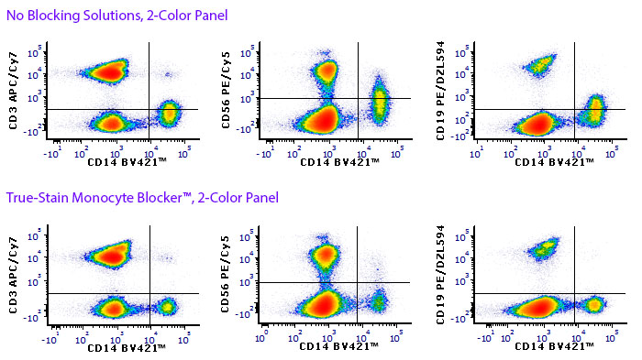
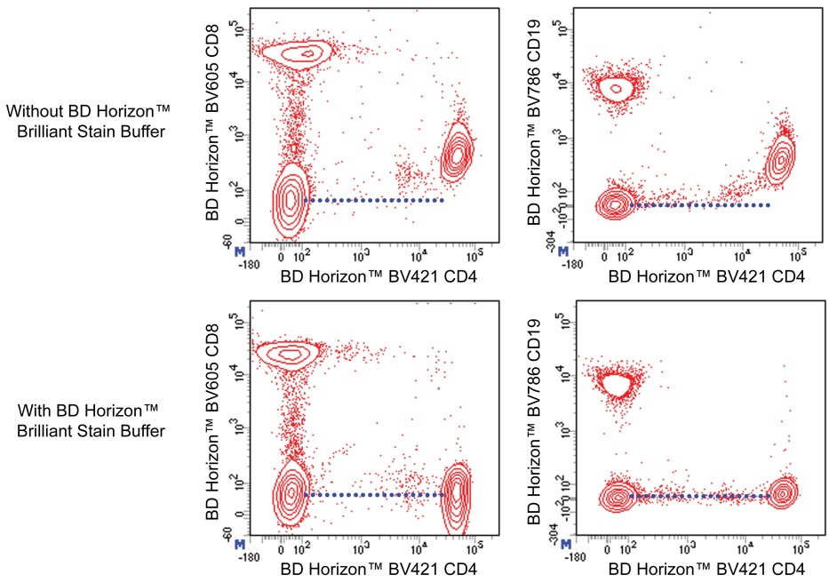
Blocking: not just an issues of Fc receptors
Non-specific binding of monocytes to fluorophors (esp. tandems)
Biolegend True-Stain Monocyte Blocker
Miltenyi Human Tandem Signal Enhancer
BD Brilliant Stain Buffer minimizes fluorophor interaction which might cause staining artifacts
https://www.biolegend.com/Files/Images/BioLegend/monocyte_blocker/MonoBlock_Fig1a.jpg
https://www.bdbiosciences.com/content/dam/bdb/products/global/reagents/flow-cytometry-reagents/research-reagents/buffers-and-supporting-reagents-ruo/563794_base/BD_Horizon_Brilliant_Stain_Buffer_Figure.png
7
Core Facility for Cell Sorting and Cell Analysis

Slide 8
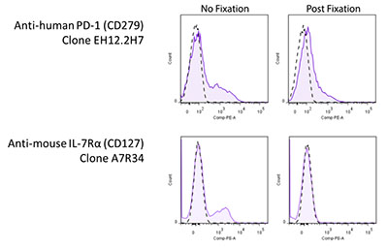
Fixation: prior and/or after surface staining
~4-5% formaldehyd or paraformaldehyd or in combination with methanol
might reduce fluorophor intensity or even degrade tandem dyes
BioLegend Fluorofix Buffer (4h storage, afterwards in cell staining buffer)
might demask/denature epitope
commercially often in set with perm buffer
8
Core Facility for Cell Sorting and Cell Analysis

Slide 9
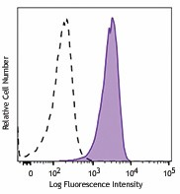
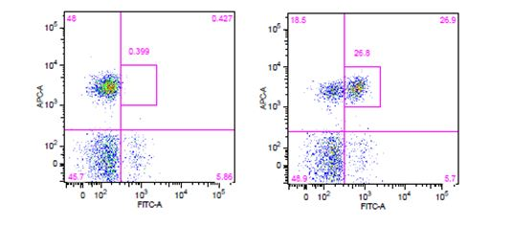
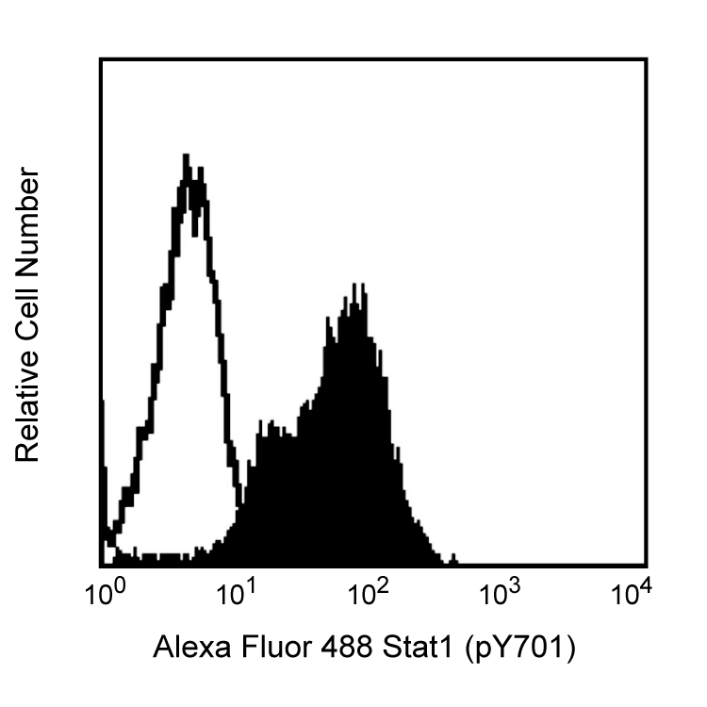
Intracellular staining: permeabilization
https://www.biolegend.com/en-gb/products/true-phos-perm-buffer-12691?GroupID=GROUP22
for cytokine and chemokine staining (FA-, saponin based):
BD Cytofix/Cytoperm Fix/Perm Solution
BioLegend Cyto-Fast Fix/Perm Buffer Set
BioLegend Intracellular Staining Perm/Wash Buffer 10X
human lymphos IL-4 stimulated (filled) or unstim (open)
for phospho-proteins (methanol-based)
BioLegend True-Phos Perm Buffer
not compatible with all cell surface markers!
Recomm.: surface staining afterwards
BD Phosflow Perm Buffer III
-20°C or on ice
always dilute antibodies in perm buffer
pSTAT6
Human whole blood was stimulated with (right) or without (left) IL-6 for 15 minutes, then treated with RBC/Lysis Fixation Solution and permeabilized with True-Phos™ Perm Buffer
CD3
pSTAT3
fresh PBMCs IFN-a stimulated (filled) vs. untreated (open)
https://www.bdbiosciences.com/content/dam/bdb/products/global/reagents/cell-preparation-separation-reagents/blood-lysis/staining-and-cell-preparation/558050_base/558050_image_1.png
9

Slide 10
Intranuclear staining: permeabilization
for nucleus proteins harsh fix/perm:
FA Fixation
BioLegend True-Nuclear Transcription Factor buffer set: Saponin-based perm
fix (~ 20% FA): step 45-60min at RT
perm/wash (saponin)
30 min RT incubation with intranuclear antibody at RT in perm buffer
BD Transcription Factor Buffer Set
fix/perm (5-10% FA, 1-3% methanol): step 40-50 min at 2-8°C
perm/wash (saponin):
40-50 min incubation with intranuclear antibody at 2-8°C in perm buffer
choice of buffers depends on surface staining fluorophors
10

Slide 11
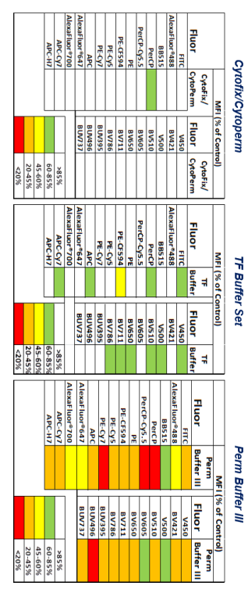
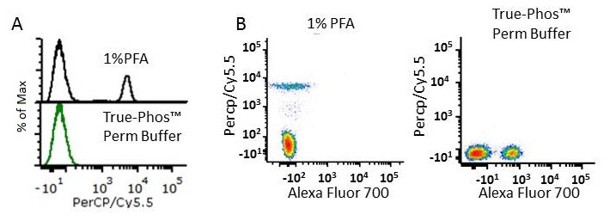
Tandem dye stability upon fixation
Fix: 4,2 % FA
Perm/Wash: Saponin
Fix/Perm: 5% FA
Perm/Wash: 1-3% Methanol
Perm: 88% Methanol
from BD PhosFlow Kit
https://www.biolegend.com/Files/Images/BioLegend/blog/052418tandemblog/Figure_2.jpg
11
Cy5.5
Cy5.5

Slide 12
Special buffers: functional assays, a.s.f.
RBC lysis buffer (self-made)
1,5 M NH₄Cl 100 mM NaHCO₃ oder KHCO₃ 10 mM EDTA pH 7,4 fill up to 1 L with AquaDest
AnnexinV binding buffer
AnnexinV is Calcium-dependent
incubation at RT
10 mM HEPES, pH 7,4 140 mM NaCl 2,5 mM CaCl₂
Cell cycle
30 min ati RT in the dark or o.n. at 4°C
1 x PBS 0,1 % (w/v) Triton-X 10 µg/mL RNAse 20 µg/mL PI
12
Core Facility for Cell Sorting and Cell Analysis

Slide 13
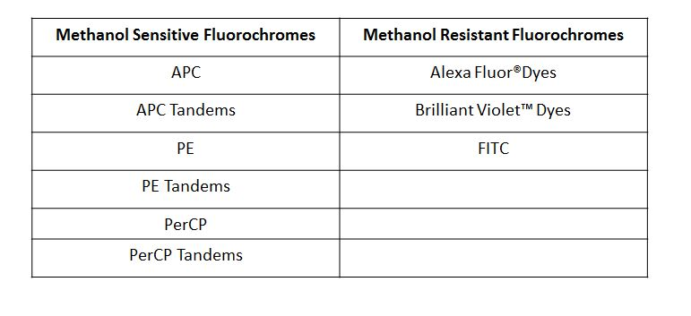
Buffer choice: Take home message
check target localization (surface, cytoplasmatic, intranuclear) and select correct buffer system
check fluorophor fixation stability
check target fixation stability
https://www.biolegend.com/fixation
13
Core Facility for Cell Sorting and Cell Analysis

Slide 14
Thank you for your attention. See you next month: 1st August Next topic The golden rules of panel design
Core Facility for Cell Sorting and Cell Analysis

