Slide 1
What is wrong with my flow cytometry data?
Hints, tricks and pitfalls
Core Facility for Cell Sorting and Cell Analysis

Slide 2
Webinar 4
02.05.2023
Compensation and unmixing:
Discover errors and correct them
2

Slide 3
Everything has to do with spectral overlap…
Fluorescence dyes are NOT excited by only one laser and do NOT have a sharp emission peak
Emission peaks do overlap
https://www.miltenyibiotec.com/DE-en/resources/macs-academy/on-demand-webinars-and-tutorials.html#
Core Facility for Cell sorting and Cell analysis

Slide 4
How to correct for spectral overlap…
Compensation
process to correct for spectral spillover of one fluorescence dye to neighbouring detection channels
Unmixing
calculates the contribution of each known fluorophore’s spectra to the total collected emission signal
Empirically calculated from single stain controls in multi-color experiments
‚false‘ signals
Core Facility for Cell sorting and Cell analysis

Slide 5
Compensation…more or less?
https://www.miltenyibiotec.com/DE-en/resources/macs-academy/on-demand-webinars-and-tutorials.html#

Slide 6
Compensation…more or less?
spillover
spread
https://www.miltenyibiotec.com/DE-en/resources/macs-academy/on-demand-webinars-and-tutorials.html#

Slide 7
Spillover spread…is?
spread: mathematical introduced because of compensation/unmixing
brighter dyes → bigger spread
depends on dyes → important for panel design
spillover
spread
https://www.researchgate.net/figure/Spreading-error-and-loss-of-detection-sensitivity-a-APC-data-spread-into-the-Alexa_fig2_310494404

Slide 8
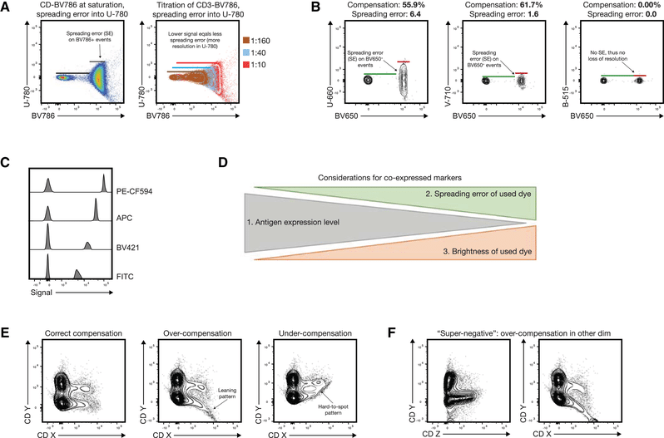
Spillover spread…is?
Guidelines for the use of flow cytometry and cell sorting in immunological studies (third edition) - Scientific Figure on ResearchGate. Available from: https://www.researchgate.net/figure/Spreading-error-and-fluorochrome-brightness-in-panel-design-and-common-compensation_fig4_356873359 [accessed 30 Apr, 2023]

Slide 9
Golden rules for compensation/reference controls
Ctrls must be stained with only ONE fluorophor
Ctrls need to be as bright or even brighter as the samples fully stained
Ctrls must contain a negative and a positive population (unstained)
Background (autofluorescence) of positive and negative population needs to be the same
→ compare cells with cells, beads with beads
Ctrl dye must fit experimental color → FITC ≠ GFP ≠ AF488
Beads good for rare cell markers or use higher expressed markers
Tandem-dyes differ from lot to lot
Buffers, fixation, … may change the fluorophors → changes in compensation

Slide 10
Golden rules for compensation/reference controls

Slide 11
Compensation Matrix in FlowJo
FlowJo allows different ways for compensation
to start from scratch
to use assisted calculation
edit matrix from aquisition
Special case – the BD FACS Calibur
if compensated during acquisition data will be saved
→ no way back to the uncompensated data
BUT post-acq editing via FlowJo

Slide 12
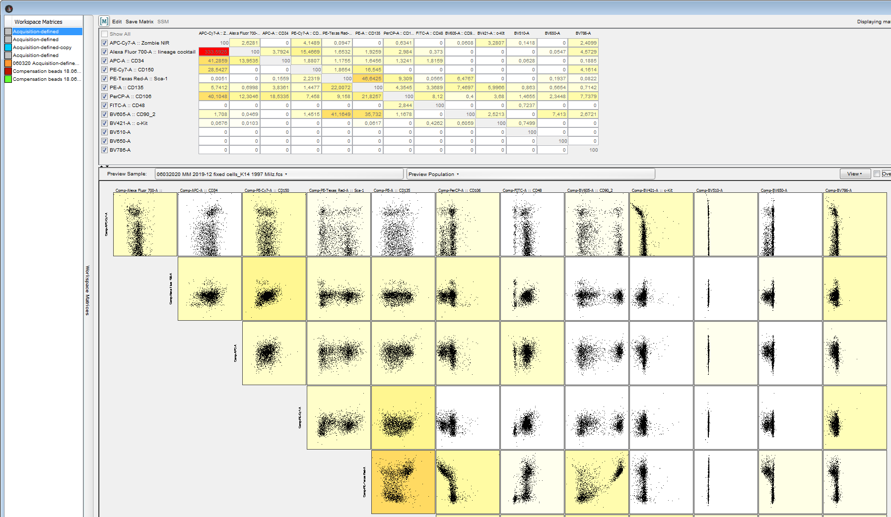
Compensation Matrix in FlowJo

Slide 13
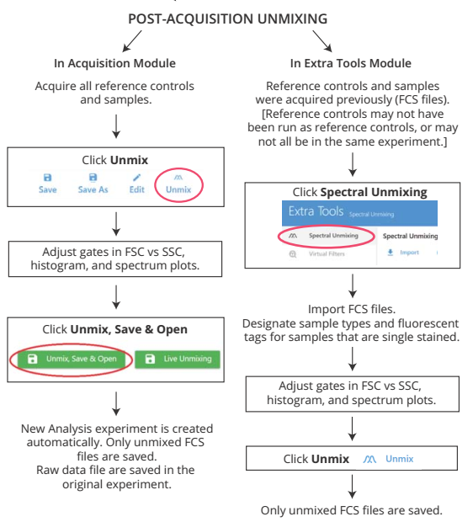
Post-acquisition unmixing in SpectroFlo

Slide 14
Compensation/Unmixing: Take home message
Compensation/unmixing of multi-color experiment is calculated from single stain controls
Single stained ctrl as bright or even brighter than sample
Use alternative markers/beads when signal is dim
Titrate antibodies
Autofluorescence of positive and negative fraction for each marker needs to be the same
Spread is introduced and can’t be avoided (pay attention to expert panel design)
FlowJo allows to view/edit or create new compensation matrices

Slide 15
Thank you for your attention. See you next month: 6th June Next topic The alpha and omega of preparing cells for flow cytometry

